Slide 1
Brand Identity: How to Promote Yourself Online
By Ashton Rose Archer

Slide 2
Resources to Professional Networking
Resume
Business cards
Personal Website
LinkedIn Profile
Professional Society

Slide 3
Why is Brand Identity important?
It makes you stand out from your peers/competitors.
It separates you from others who may have the same name.
You are a product, and you want companies/employers to choose you!
Ashton Archer vs. Ashton Rose Archer

Slide 4
Building an Online Presence
It’s important for employers and universities to be able to find you online.
Everyone has a digital footprint. Make sure it’s a positive one!
Google yourself regularly. There may be information about you that you cannot control.
Example: Friend has less secure privacy setting on Facebook and puts up a photo of you really drunk.
Don’t even need to tag you for it to be traced to you. Google’s image search can find you!

Slide 5
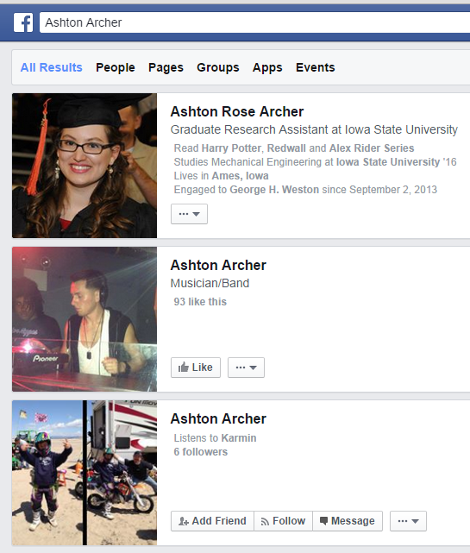
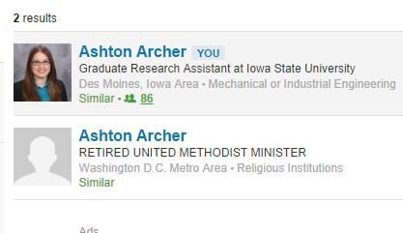
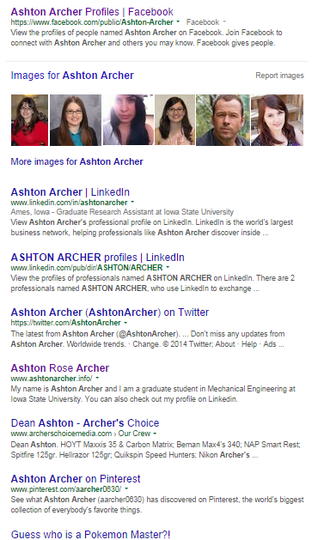
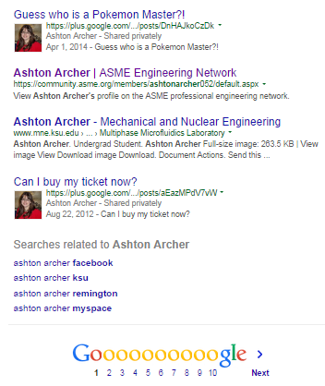
What’s on your 1st page of Google?

Slide 6
Monitor your online presence
Something you would prefer an employer not see?
Check your privacy settings on your social media websites.
Don’t forget about Pinterest!
Things you’ve pinned can be found in search engines!

Slide 7
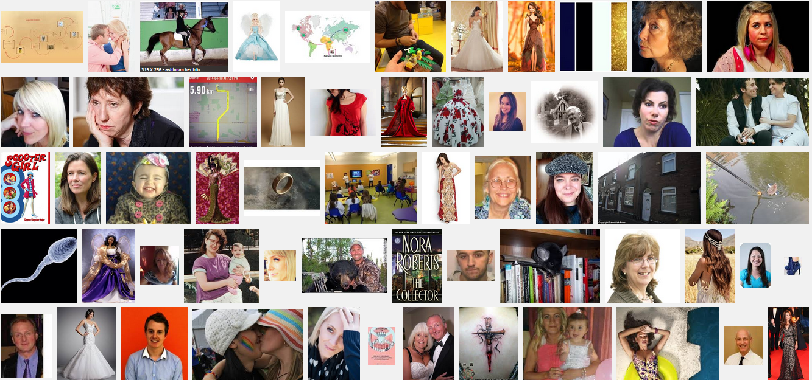
Things I’ve pinned (in red)!!! This is what comes up when I do an image search of “Ashton Archer.”
Notes:
Purple circles are images from my website

Slide 8
Building a Website
What you will need:
Google account
Credit/debit card
A good or professional profile picture
A copy of your resume/CV.
You will what to think about who is your target audience?
That will determine what types of pages you may have.

Slide 9
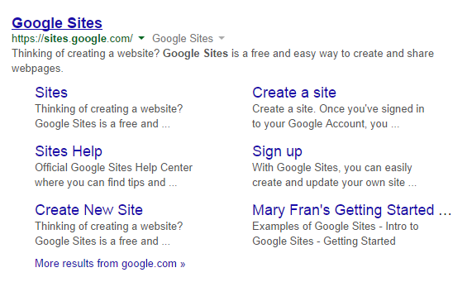
Step 1: Go to Google Sites
Step 2: Select CREATE on Google Sites

Slide 10
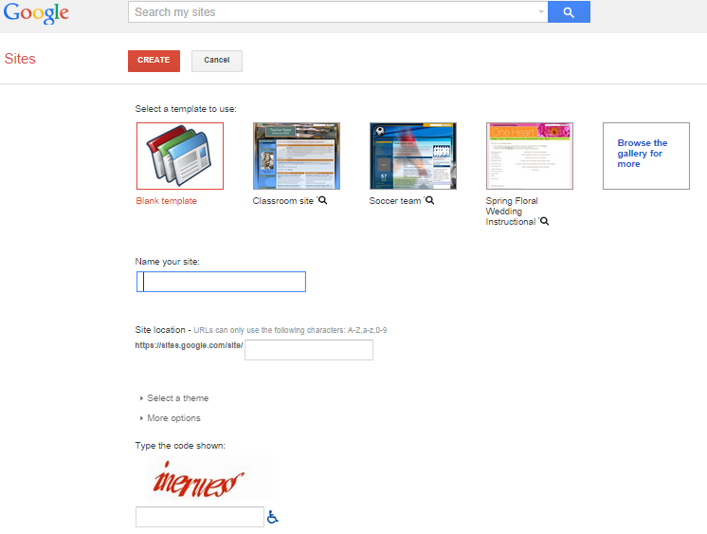
Step 3: Pick a Template

Slide 11
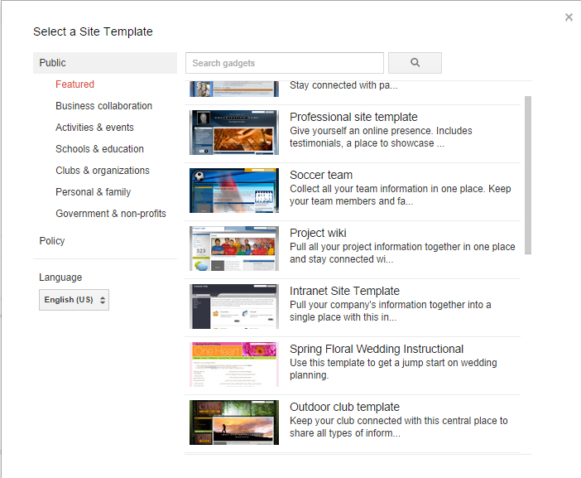
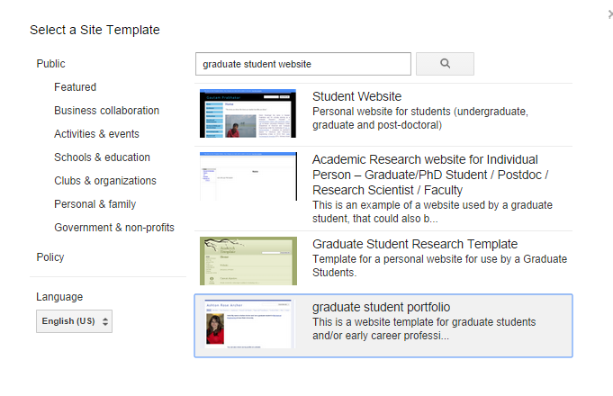
A pop-up window will appear and you can search through different types of templates available.
Of if you like my website, you can use my template.
Search “graduate student website”

Slide 12
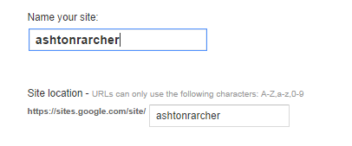
Almost there!!
After selecting your template, you’ll need to name your site. The basic URL will be based on the name of your website.

Slide 13
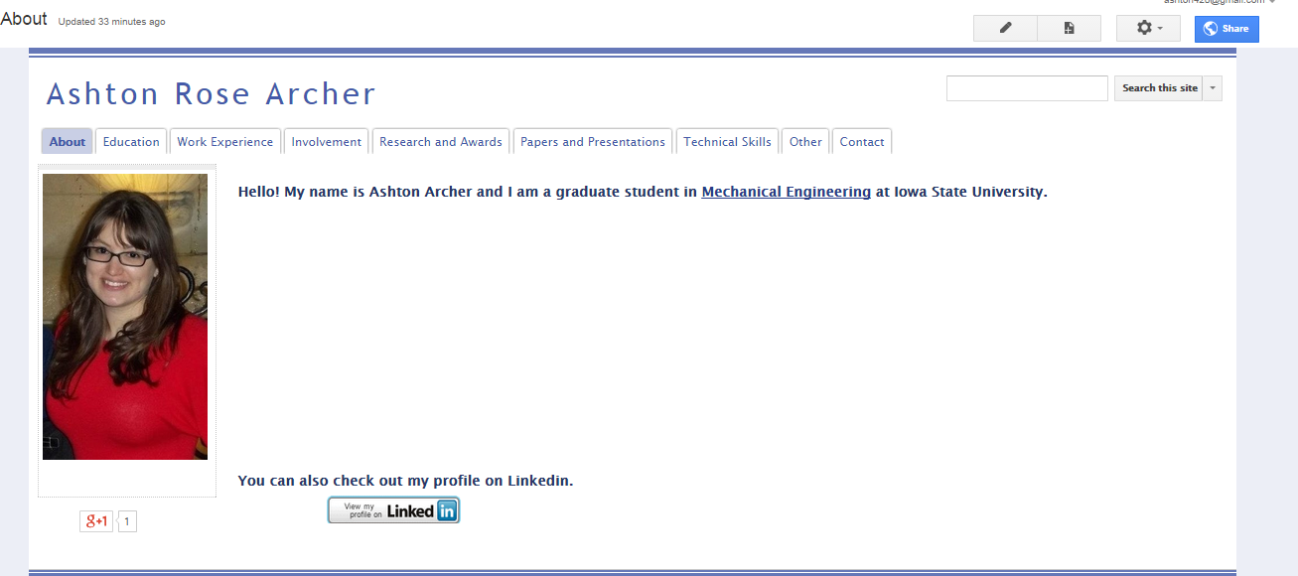
Edit Page
Manage site
Your pretty face!
Widget!!!
Notes:
If you use the “graduate student template”, to change the picture on the left hand side, follow these steps.
Select the Gear symbol in the right hand corner. Select “Edit Site Layout”. You can then edit the image in the left side bar, you can change the header of the page. You can also change whether the navigation tabs are horizontal or vertical.

Slide 14
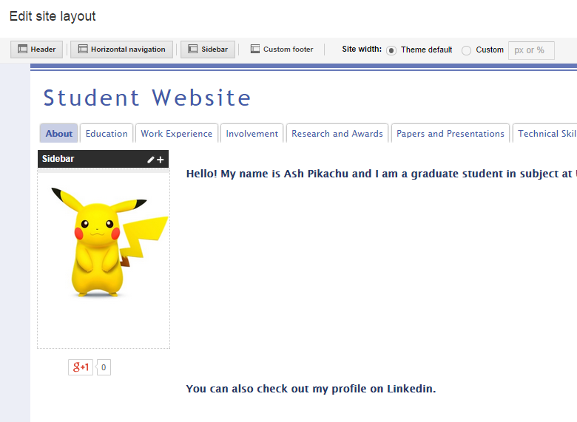
Edit Site Layout
By editing Site Layout
You can add or remove the header, sidebar, footer, and navitation.
If you use the “graduate student template”, to change the picture on the left hand side, follow these steps.
Select the Gear symbol in the right hand corner. Select “Edit Site Layout”. You can then edit the image in the left side bar, you can change the header of the page

Slide 15
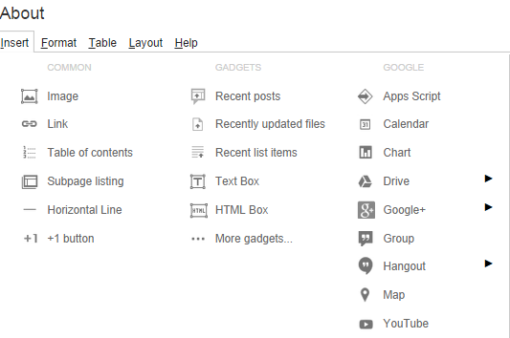
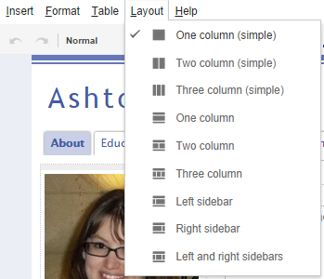
Once in Edit Mode….
Notes:
Once in Edit Mode you can customized each page to suit your tastes! You can add images, links, subpage, embedded a document, add a GooglePlus button, a map, a Youtube video! You can change the layout of the page as well.

Slide 16
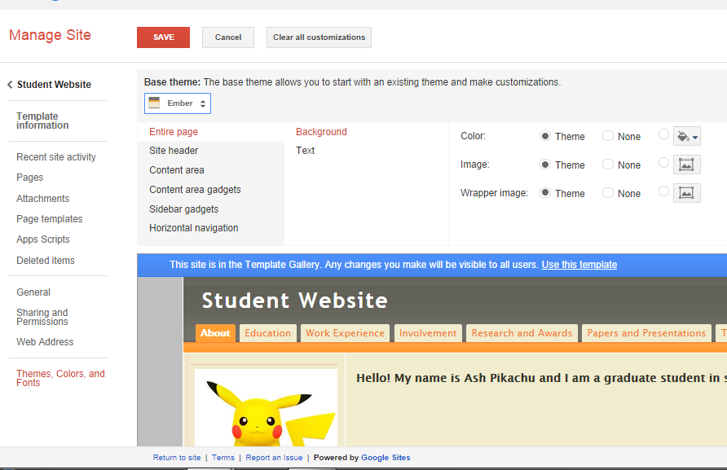
Changing the color scheme of your site
Go to the Gear symbol and Select Manage Site.
Then Select ‘Themes, Colors, and Fonts’ from the left sidebar.
Here you can use preset color combinations to customize your site and then preview those changes.

Slide 17
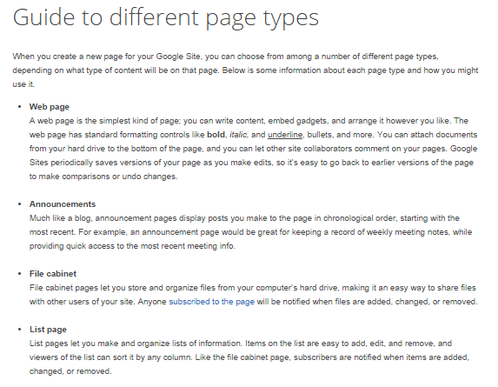
Make Different Types of Pages
Google Sites Help has lots of easy to understand answers if you get confused!

Slide 18
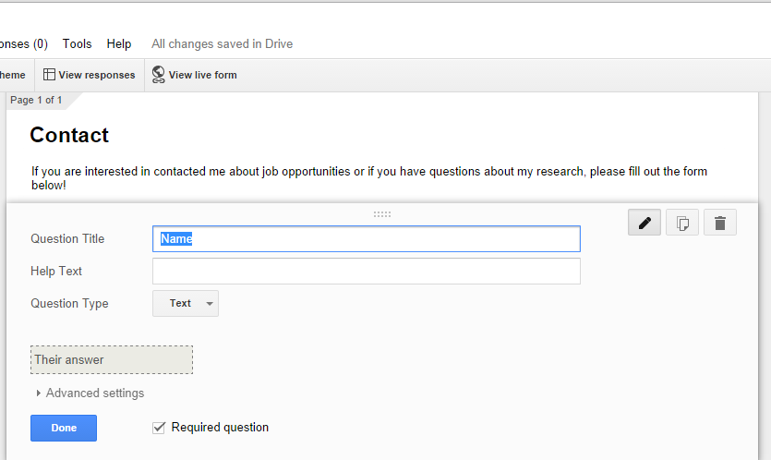
Adding a Contact Form to Website
Go to Google Docs or Drive
Create a “Form”
Add sections to Form.
Name, Email, Question box.
Save the Form

Slide 19
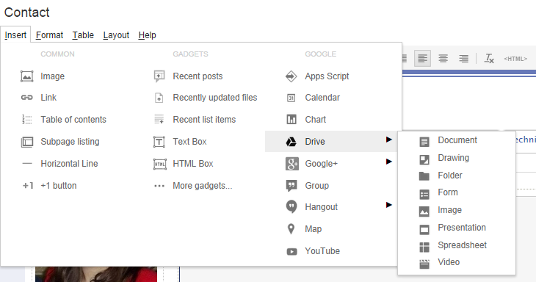
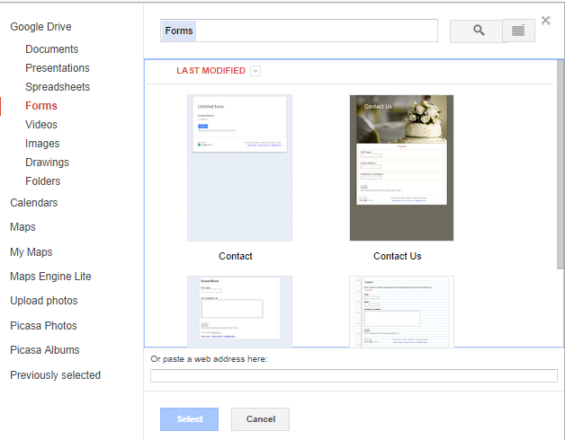
Go back to your site, to the page you want to add the form to.
Edit the Page, and select Insert.
Hover over “Drive” and select “Form”.
The saved form in your Google Drive should appear, as pictured to the left.
Select the Form you want to use.

Slide 20
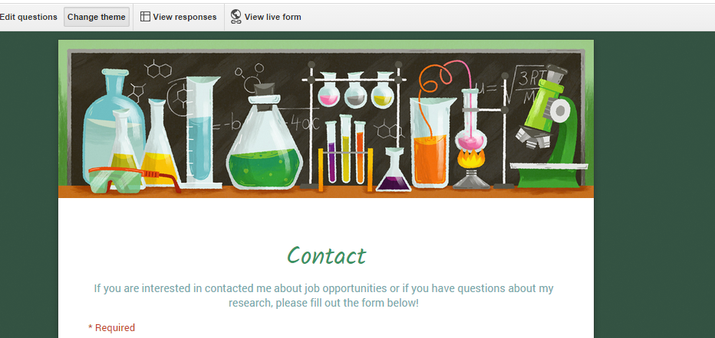
Bonus!!!
You can choose a theme to make your form look fancy.

Slide 21
Adding Google Analytics to your site
Will allow you to analyze who is viewing your site and from where.
Will give you insights to what viewers are looking at on your site.
Page specific.
Are they actually reading the content on the page? It will tell you how long a viewer will stay on a page before moving to another page or leaving the site.
Will tell you about visitors who are returning versus new viewers.
Free with Google sites and I think other sites as well.

Slide 22
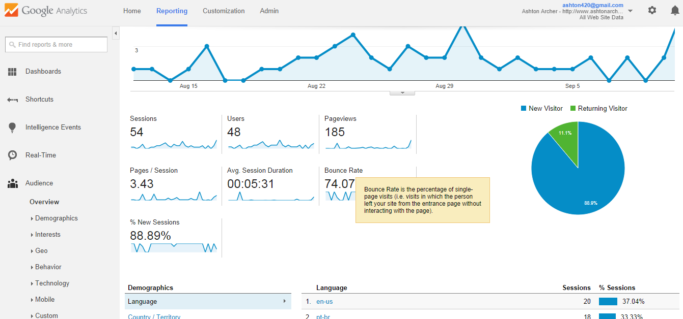
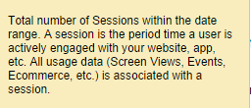
Notes:
Google Analytics breaks down the data very simply. For the Given time set (1 month), my website has been viewed 54 times. Views are listed as “Sessions”. 48 Different users accessed my page. So that means people came back more than once.

Slide 23
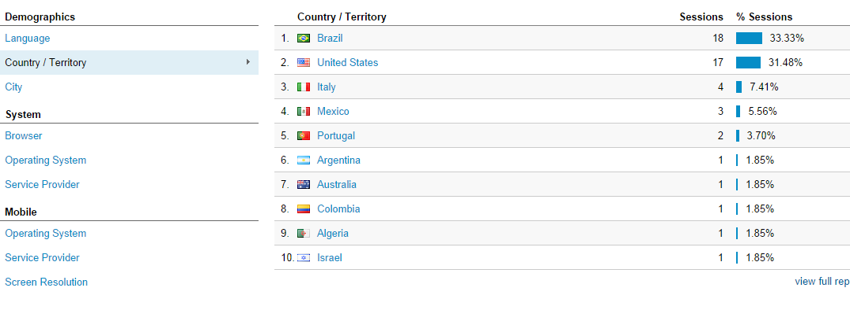
Geographical Information about viewers.
You can learn about who is looking you up. This is also great to use after you attend conferences, because you can see how people you met went online to learn more about you.

Slide 24
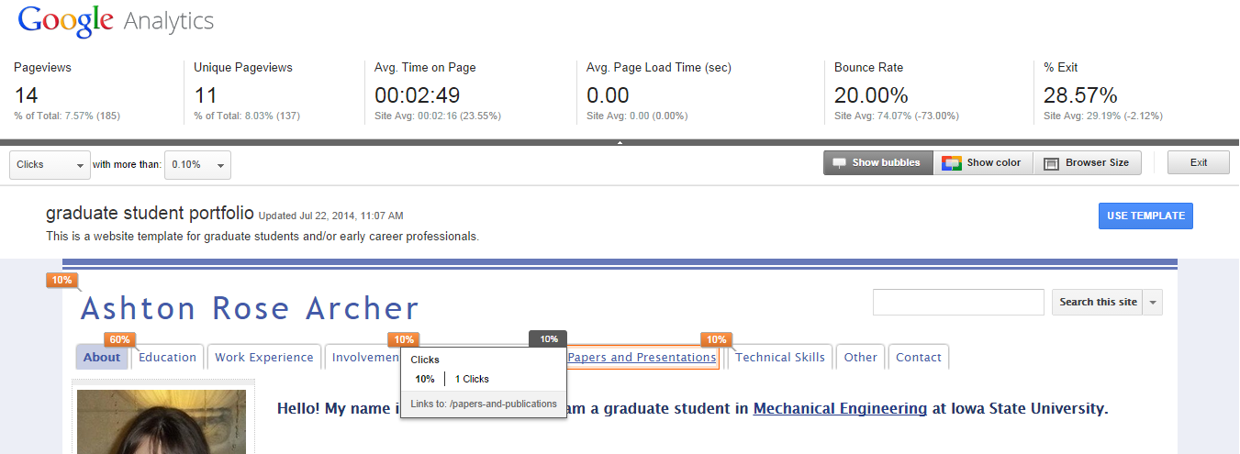
Where are people going on your website?

Slide 25
Purchasing a Domain Name
www.godaddy.com
www.1and1.com
.info extensions are cheaper than .com
Should purchase it for at least 2+ years.
This makes it cheaper and less of a hassle to renew.
Sign up with an email that you aren’t going to lose access to.
Your domain name should match your Brand Identity.
Are you going to be changing your name in the future?
To attach your domain name to the website you just made, follow along with this video: https://www.youtube.com/watch?v=1bFzeI7NxLw

Slide 26
Domain Name versus URL
The exact URL of my template site is: https://sites.google.com/site/studentwebsitepromote/
This is already a really long URL because it’s hosted by Google. So to make it easier, I might purchase a domain name. Then people don’t necessarily know it’s hosted by Google.
So to make it easier for people to get there, I can buy a domain name such as : www.studenttemplate.info to make it easier for people to get there.
From netforbeginners.about.com
People don’t like to type slash marks!
Makes it short and sweet.

Slide 27
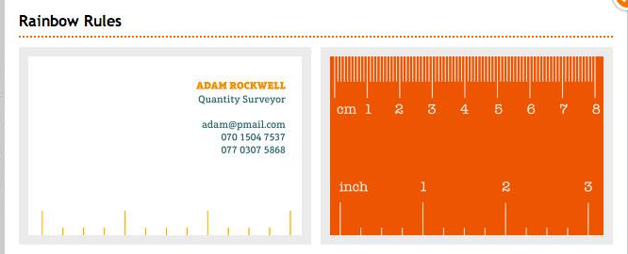
Business Cards
Business cards are a great tool for networking.
Think of it as a mini-resume!
Business cards can be fun and professional.
If people think your card is interesting, they’ll keep it or at least remember it!
Don’t go overboard though.
Websites for business cards.
Vistaprint.com
Moo.com
Print your own with Avery.

Slide 28
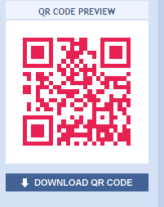
Adding a QR Code
QR codes can be read by smartphones that have a QR app.
This code can be set up to take the viewer/scanner directly to your website, LinkedIn profile, or a digital resume!
http://www.qrstuff.com/
You can even change the color of your QR code to match your business cards.
It’s FREE!!!
Add QR code as an image to your business card.

Slide 29
So, in closing.
Update and expand your LinkedIn profile, employers are looking for you!
If your professional society has a networking component of their sites, utilized it.
Google yourself a couple of times a year to see how others view you online.
Check your privacy settings on your social media accounts.
If you decide to build a website to promote yourself, update it regularly just like you do with your resume. Don’t wait until the day before an interview or a career fair. Your resume/website should be dynamic and be constantly updated. You don’t want outdated material to be hindrance.
If you decided to purchase business cards, don’t buy too many (more than 100) in case you get a promotion or your phone changes. Don’t put more information on them than you comfortable with people having.
You don’t have to put your phone number on your card. As long as there is some method of contact, such as email you are okay.
If you need assistance or help with building your website, feel free to contact me at ararcher@iastate.edu.

